Slide 1
R&R In Communities User Flows

Slide 2
Research Flow
User comes to site without a product in mind
Clicks on Reviews Tab
Clicks on a subcategory
Subcat Research Page
Able to sort and filter for relevant products
WCS
Lists of top rated subcategories within a category
Sees top rated brands within category
Top rated items:
Read Review
Write a Review
Read reviews on a specific product on See All Reviews Page
Write review on WCS WAR form
Related stories (Blogs, guides, recent Q&A)
Communities
Read Blog
Read Buying Guide
Read Q&A
Link back to Communities from See All Reviews Page

Slide 3
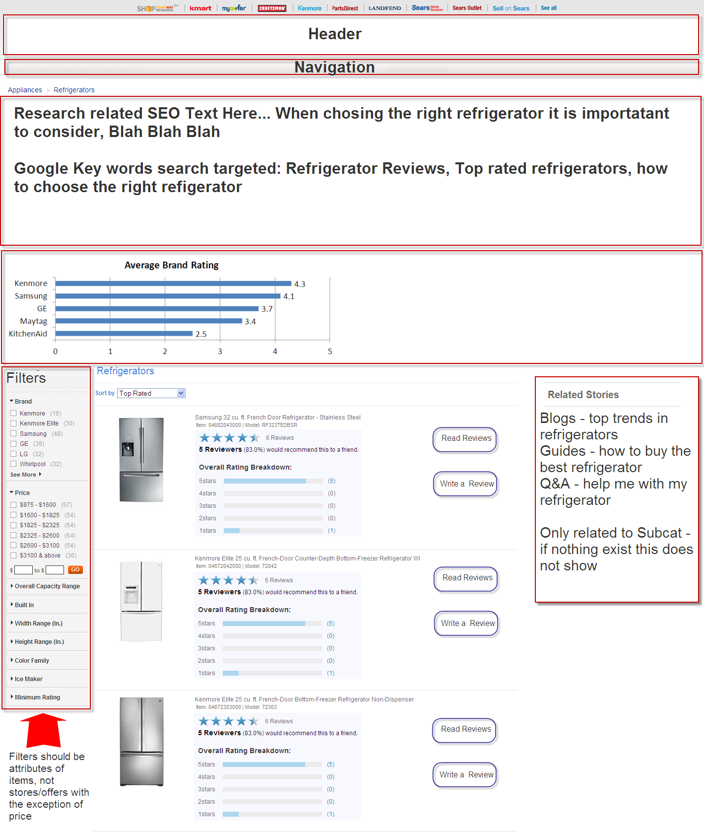

Slide 4
Community Browsing Flow
User is browsing Category Interest Page
Reviews RSS
(most recent reviews in that Category)
Clicks on recently reviewed product
WCS See All Reviews Page
Link back to Communities from See All Reviews Page

Slide 5
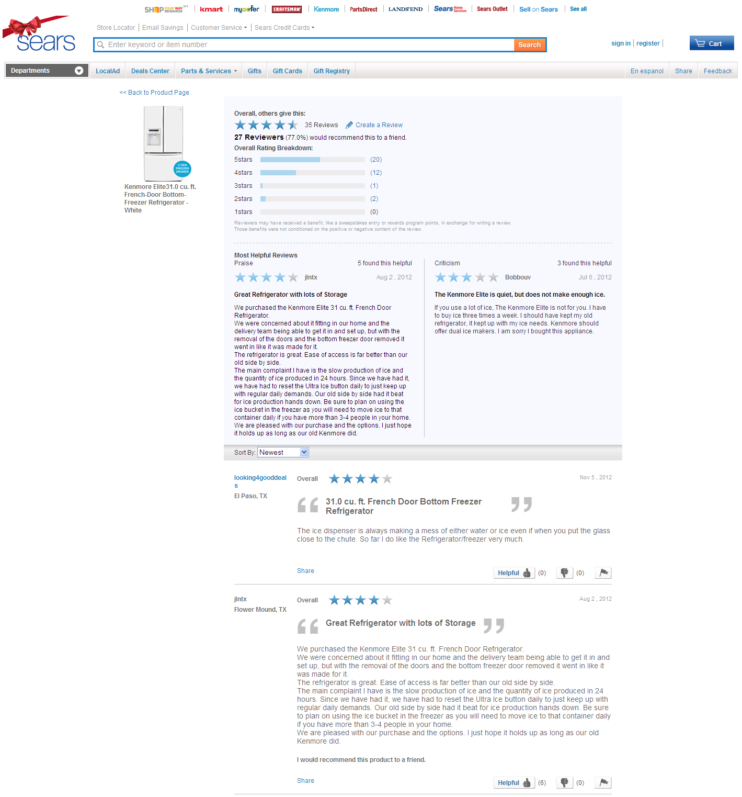
Existing See All Reviews Page

Slide 6
Search Flow
Link back to Communities from See All Reviews Page
User comes to site to read or write a review
Searches Product
Search results show all products with rating and count
Write: WCS WAR Form
Write reviews on a specific product
Read reviews (conditional on there being reviews)
Write a review
Read: WCS See All Reviews Page
Read reviews on a specific product

Slide 7
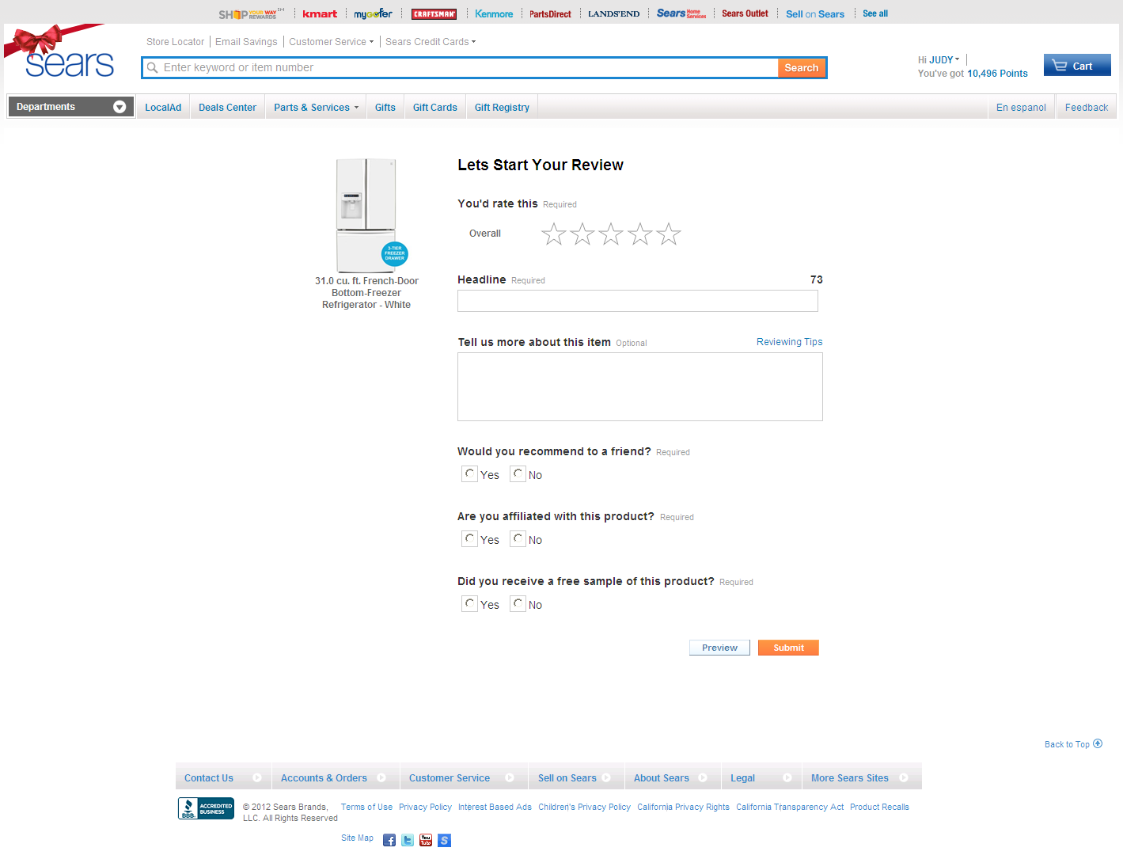
Existing WAR form

Slide 8
Requirements and Dependencies
Requirements
Universal Header
API integration
Dependencies
Product Catalog API
R&R API
R&R RSS
SolrX API filtering layer

Slide 9
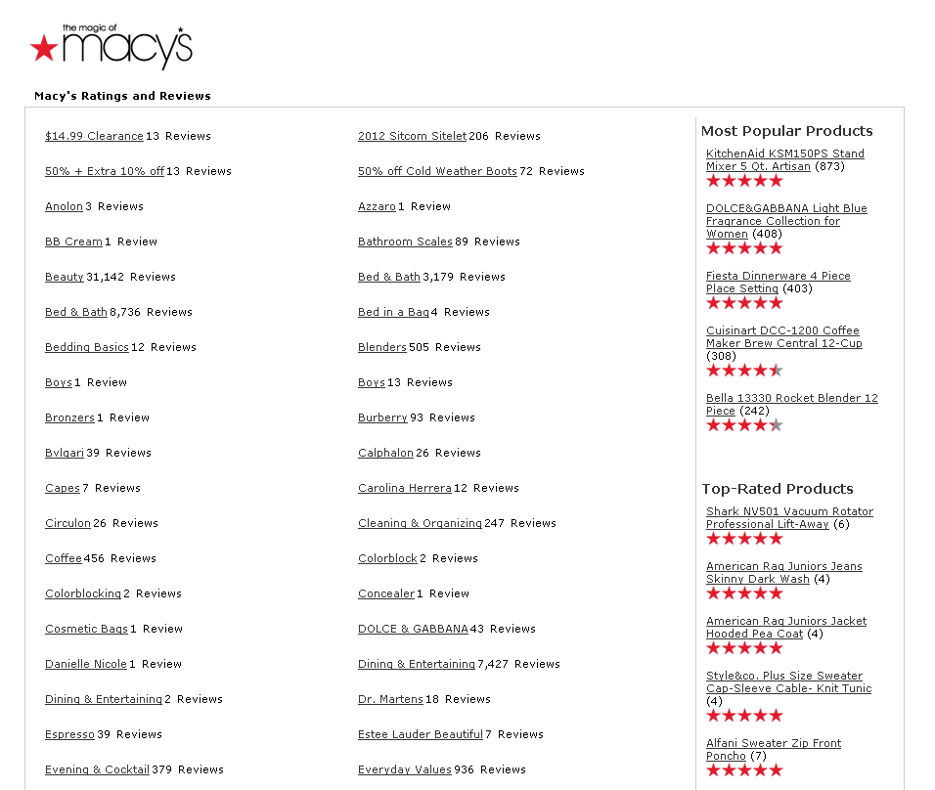
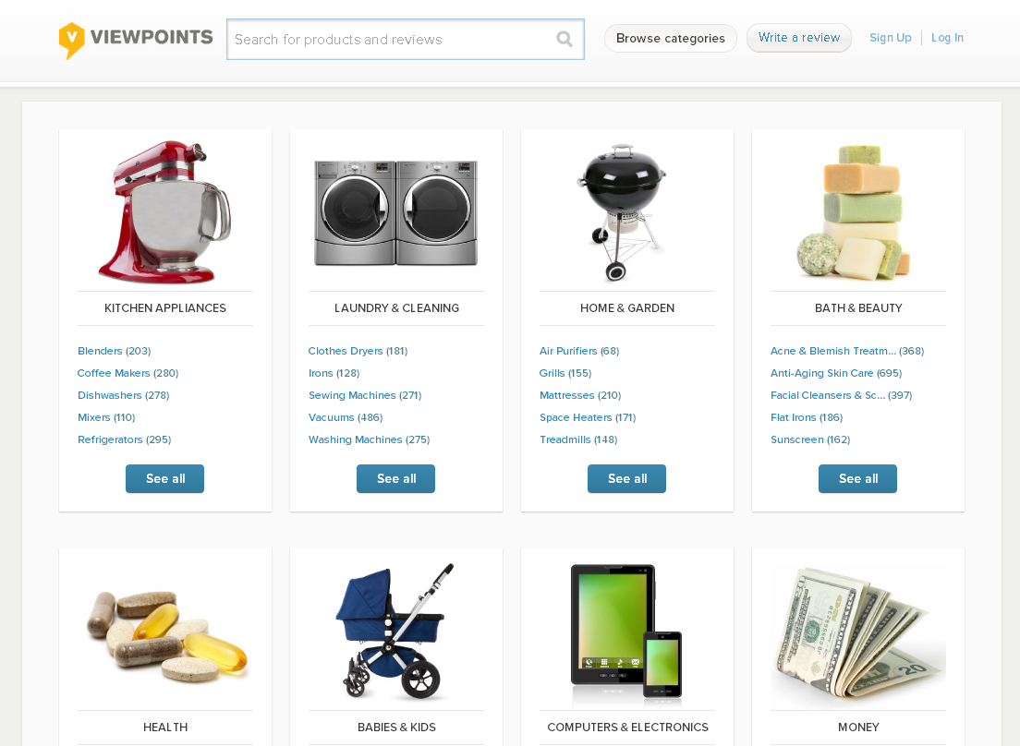
Example: Competitor Reviews Tabs
http://www.viewpoints.com/explore
http://reviews.homedepot.com/1999/allreviews.htm
http://reviews.macys.com/7129/allreviews.htm

Slide 10
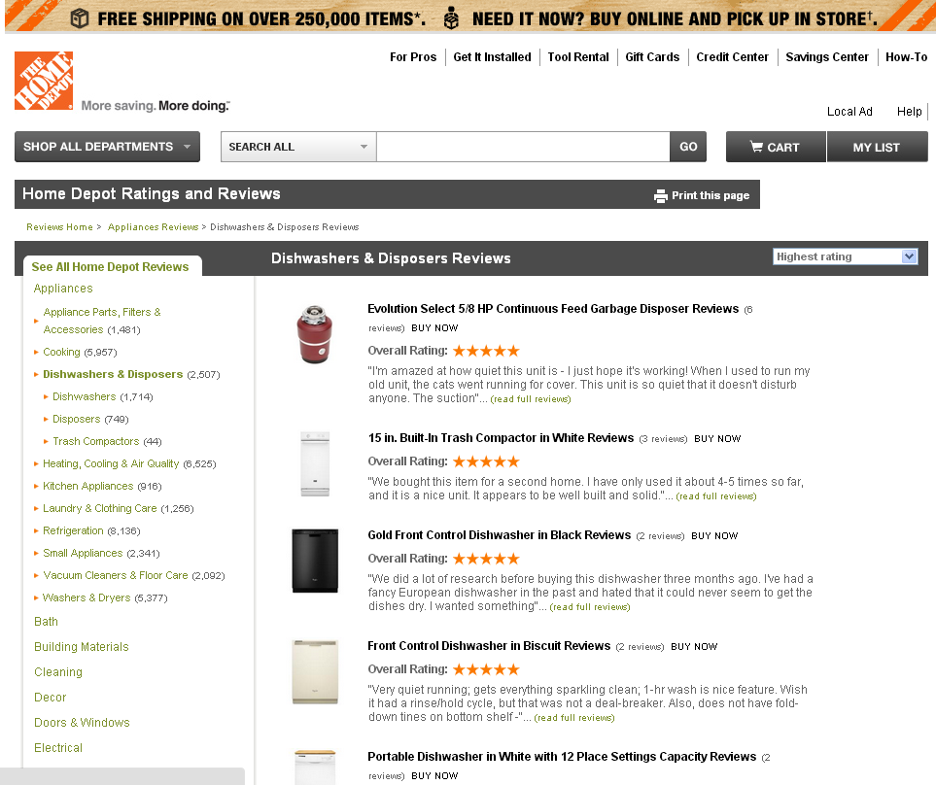
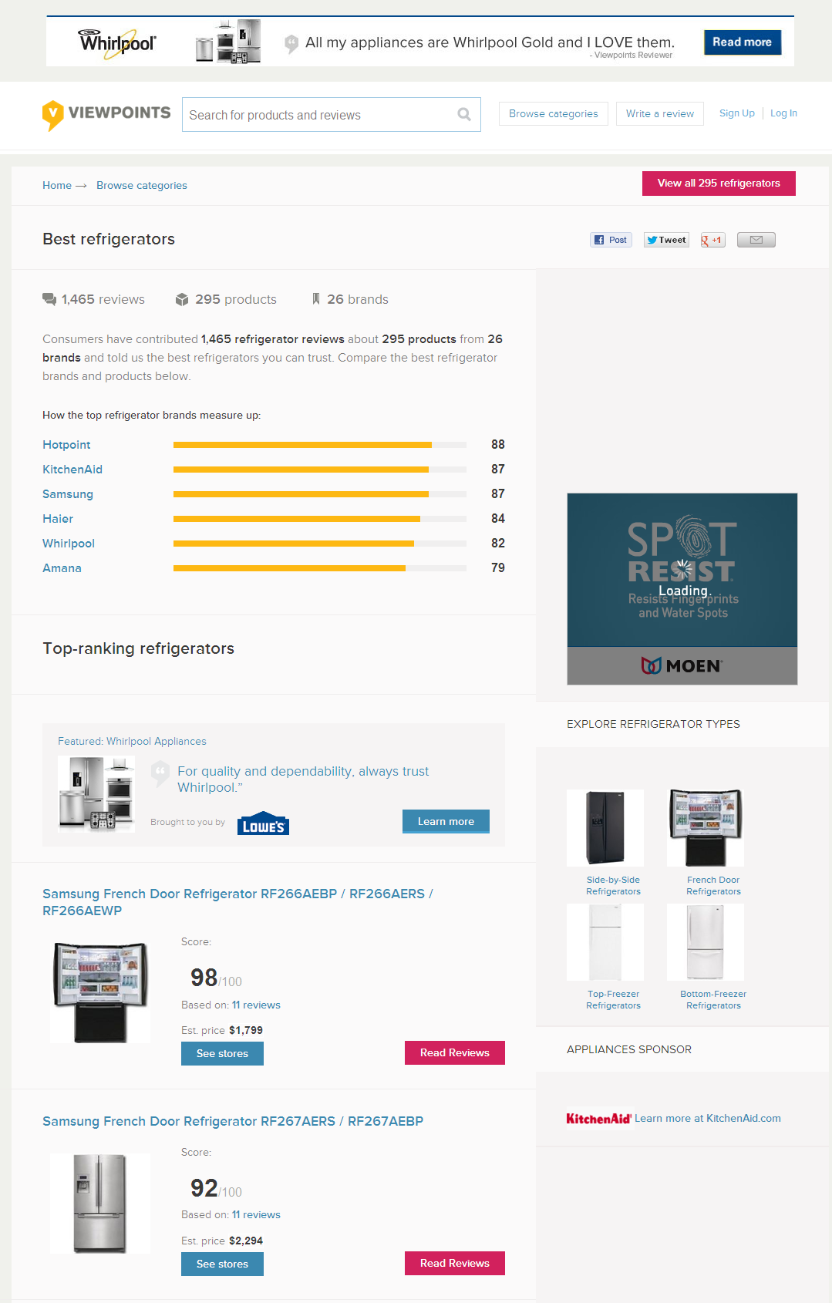
Example: Competitor Subcategory Pages
http://www.viewpoints.com/Refrigerators
http://reviews.homedepot.com/1999/b247db53-a631-404b-9dce-d7a0e18b9b0d/dishwashers-disposers-reviews/category.htm
http://reviews.macys.com/7129/62217/home-reviews/category.htm

